Slide 1



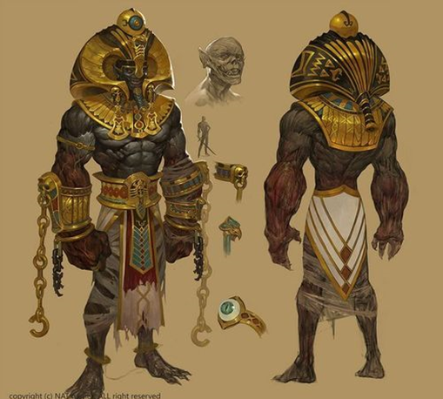
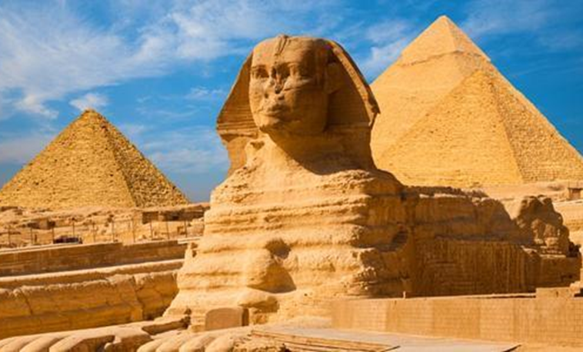
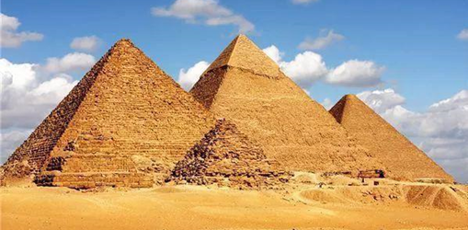
Introduction
Egypt
Date of cultural origin: Tassa culture 5000 B.C.
Port name: Alexandria Port
Egyptian culture
Anubis
by the dog of Egypt
Wolves
God of the dead, protector of the dead
King Harmais
Pyramids

